Slide 1
Scottish RSL pensions webinar
Scottish Housing Association Pension Scheme (SHAPS) valuation results
October 2025

Slide 2



Presenters
Alistair Russell-Smith
Head of Charity / Not-for-Profit Practice
alistair_russell-smith@ spenceandpartners.co.uk 020 3837 2960
James Keith
Pensions Partner and Morton Fraser MacRoberts
James.keith@mfmac.com 0141 303 1329
Sean Campbell
Charity / Not-for-Profit Consultant
sean_campbell@ spenceandpartners.co.uk 0141 249 0959

Slide 3
Agenda
Pension provision in the sector
SHAPS valuation results
Deficit Recovery Contributions and Expenses
Future accrual
Broader option if also in LGPS
Consultation and contractual considerations
Implementation timescales

Slide 4
Pension provision in the sector
Defined Benefit (DB) provision
Defined Contribution (DC) provision
Local Government Pension Scheme (LGPS), e.g. Strathclyde, Lothian
Scottish Housing Association Pension Scheme (SHAPS)
Commercial DC providers
DB sections
DC section
Typically closed groups of employees still accruing DB (e.g. those employed at original stock transfer date)
DC the typical pension arrangement for recent and new hires

Slide 5
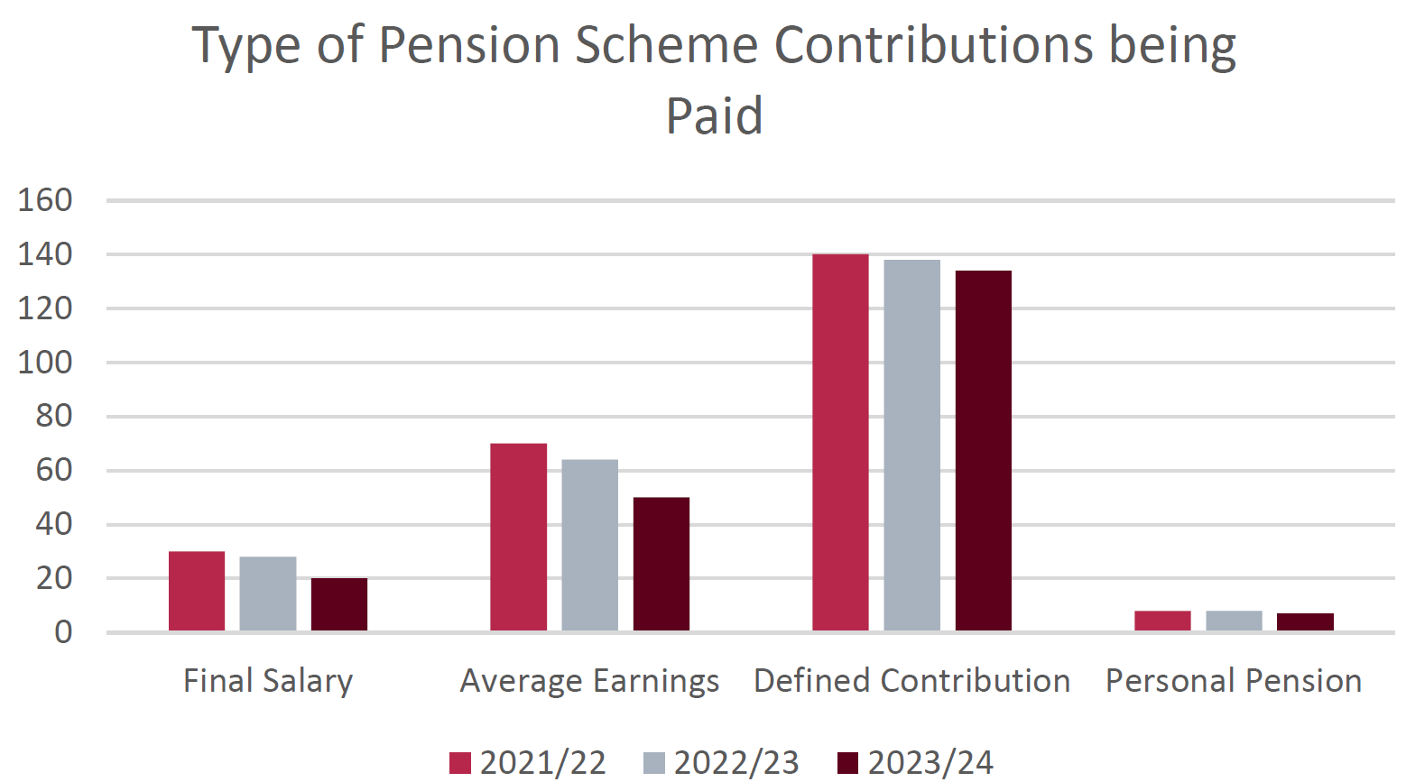
Sector benchmarking
Benchmarking data from Scottish Housing Regulator (FY24):
Spence experience on DC:
DC employer contributions in the sector typically 5% - 10%.
Most generous employer DC contribution we have seen is 12%.
Fairly common design is 2x matching where the employee pays 5% to get 10% from the employer.
Others have a 1x or 1.5x employer match.
Sometimes former SHAPS DB employees have more generous DC contributions.
The number of RSLs with DB is declining, although c. 70 still have a form of DB. Most open DB is now in LGPS because only 27 employers remain open to DB accrual in SHAPS (see next slide).

Slide 6
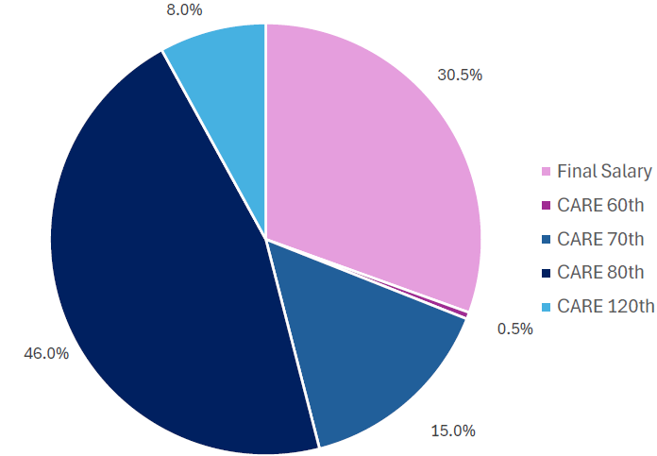
SHAPS: overview
Overview of structure:
Employer and member profile in SHAPS DB:
Two connected sections in same trust:
DB section: “last man standing” structure - current employers underwrite the liabilities of former employers.
DC section: by using SHAPS for DC, employers prevent the build up of further DB accrual without triggering the Section 75 exit debt. This is only triggered when the last employee leaves service in either the DB or the DC section.
c. 130 employers with DB liabilities, but only c. 27 allowing future accrual on a DB basis
c. 450 “active” members in SHAPS DB at 31 March 2024, compared to c. 8,000 deferred and pensioner members. The actives are split as follows amongst their 5 DB tiers:
DB section
DC section
There has been a steady flow of members from DB to DC as DB costs have increased (but 2024 valuation has led to a fall in DB costs for the first triennial valuation in many years).

Slide 7
SHAPS: 30 Sept 2024 valuation
Past service funding position:
Future service contributions:
Date and funding basis | 30.9.21 ongoing valuation | 30.9.21 Section 75 exit valuation | 30.9.24 ongoing valuation | 30.9.24 Section 75 exit valuation
Assets | £1,171m | £1,171m | £690m | £690m
Liabilities | £1,200m | £1,681m | £769m | £915m
Surplus / (Deficit) | (£27m) | (£508m) | (£80m) | (£225m)
Funding level | 98% | 70% | 90% | 75%
Date and funding basis | Current | From April 2026
Final Salary 60ths | 33% | 21%
CARE 60ths | 32% | 19%
CARE 70ths | 27% | 16%
CARE 80ths | 24% | 14%
CARE 120ths | 16% | 10%
1) Ongoing funding position deteriorated leading to recommencement of DRCs
2) Funding on an exit basis much improved
3) Significant fall in future service contributions

Slide 8
Deficit contributions and expenses
Deficit contributions:
Recommencing in April 2026 at broadly 50% of the level before they turned off in 2022.
Payable until 2030, or 2032 if the Court case leads to additional liabilities.
Can pay upfront with a 6.2% discount for early payment.
Expenses:
Contribution for expenses increasing by c. 40%, and payable beyond 2030/32 until “significant maturity.”
Employer Committee considering alternative ways to allocate expenses, which could weight expenses more towards smaller employers (as is the case in SHPS)

Slide 9
Future accrual
Keeping DB open – splitting future service contributions:
Closing DB to future accrual:
Contribution rate (CARE 80ths) | Current | Some options from 1 April 2026 onwards:
 |  | 100% savings to employer | 50% savings to employer | 0% savings to employer
Employer | 12% | 2% | 7% | 12%
Employee | 12% | 12% | 7% | 2%
Total | 24% | 14% | 14% | 14%
Business case:
Turn off more DB liability and risk
Reduce share of deficit and orphan liabilities
Align with sector trends
Same pension structure for all employees
Offer to keep paying current employer DB rate into DC for a period of time?
1) Might be necessary to help fund the recommencement of DRCs and increased expenses?
2) Possibility, particularly if costs shared as they increased
3) Unlikely?

Slide 10
Broader option if also in LGPS
Accessing an LGPS exit credit to pay the SHAPS deficit:
Replacement pension for LGPS employees:
£2m SHAPS exit debt
£0.8m SHAPS ongoing deficit
LGPS: 49ths CARE, 6% ish employee contribution
£2m LGPS surplus
SHAPS DC + salary sacrifice
SHAPS DB + 0% employee contribution
Moving employees from LGPS to SHAPS CARE 60ths with 0% employee contribution is broadly cost and benefit neutral for employees
Consider moving LGPS employees to SHAPS DC or SHAPS DB to access an LGPS exit credit

Slide 11

Consultation / contractual issues
Listed Changes:
Increasing the normal pension age specified in the scheme rules.
Closing a scheme to new members.
Stopping further benefit accrual by existing members.
Stopping the employer's liability to make further contributions to a scheme.
Requiring member contributions, where these were not previously required.
Increasing the level of member contributions.
Changing the rate at which pensions in payment are increased, or the rate at which deferred pensions or other benefits are revalued.
Any Employer with more than 50 employees will be required to carry out a consultation if it intends to make any of the ‘Listed Changes’.
Any proposal to cease accrual in the DB Section of the Scheme or change future service contributions would trigger the Consultation requirement.
The Consultation must last 60 days and all affected members (active and prospective members) must be consulted.
Where members are represented by for example a trade union or specifically appointed consultation representatives, the representative(s) must also be consulted.
Failure to consult = fine of up to £50,000.
Consultation Requirement:
If employment contracts need to be varied to effect the change or as a consequence of any change – it will be necessary to carry out a consultation under employment law.
Defective consultation process – breach of employer’s contractual duty of good faith?
Fire & re-hire? Could potentially be used in cessation of accrual situations – employee is dismissed and re-hired on an updated contract providing no entitlement to DB Membership – usually a last resort. Pending changes from October 2026 via Employment Rights Bill?
Contract considerations:

Slide 12
Implementation timescales
Close SHAPS DB to future accrual or change future service contributions:
Deadline for informing TPT of future service splits
Determine pension level / splits
Draft comms
Run employee consultation. Start by issuing letter & FAQ. Follow shortly after with presentation. Possibly provide access to IFA.
Make final decisions
Confirmatory comms and implementation
Accessing an LGPS exit credit:
Feasibility assessment
Engage with fund
Draft comms
Run employee consultation. Start by issuing letter & FAQ. Follow shortly after with presentation. Possibly provide access to IFA.
Make final decisions
Confirmatory comms and implementation
Payment of exit credit
Oct 2025
Nov 2025
Dec 2025
Jan 2026
Feb 2026
Mar 2026
New SHAPS DB contribution levels commence

