Slide 1
Your trusted LGPS experts
Webinar for employers in England & Wales LGPS funds
11 November 2025

Slide 2


Presenters
Alistair Russell-Smith
Head of Charity / Not-for-Profit Practice
alistair_russell-smith@spenceandpartners.co.uk 020 3837 2960
What we’ll be covering today:
Recap of LGPS 2022 valuations in England & Wales
31 March 2025 valuation timeline
31 March 2025 valuation results
Case study
Top tips for employers
Next steps
Sean Campbell
Charity / Not-for-Profit Consultant
Sean_Campbell@spenceandpartners.co.uk 0141 249 0959

Slide 3
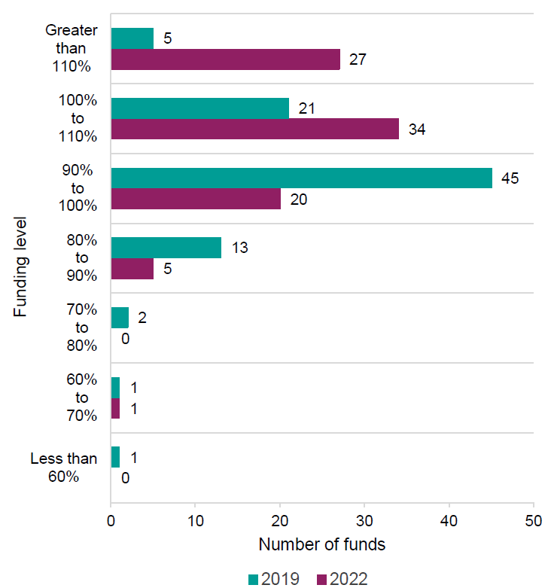
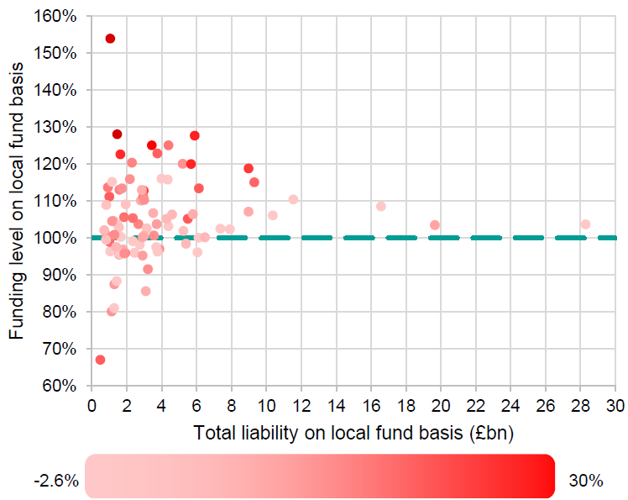
Recap of E&W 2022 valuations
Source: extracts from GAD’s Section 13 report on the 2022 valuations:
Aggregate funding level of 106% at 31 March 2022

Slide 4
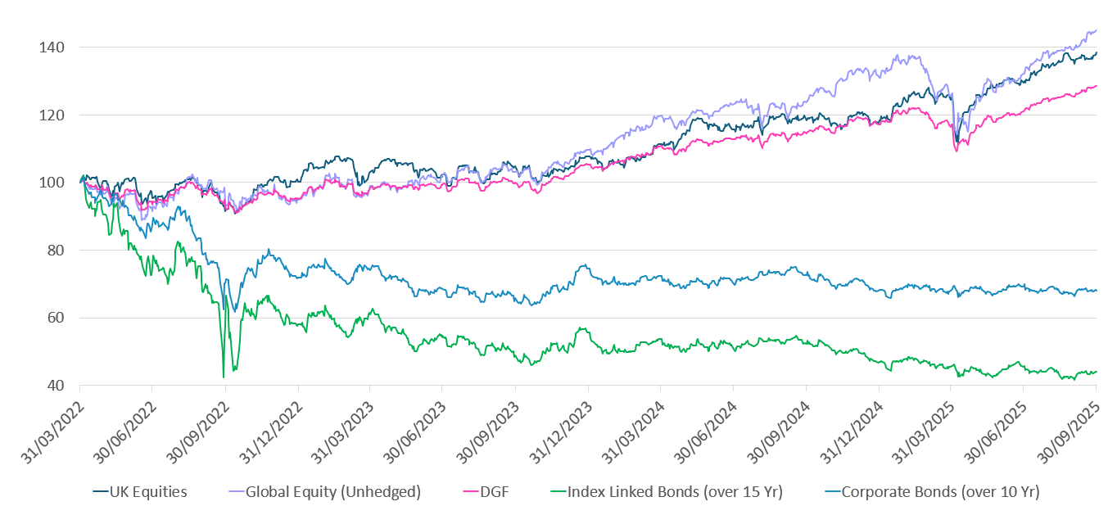
Market movements since 2022
1) Growth asset classes performed strongly since 2022
2) Falls in bonds have increased interest rates and liability discount rates
3) Further improvements since valuation date
Favourable market movements driven large increases in funding levels since 2022

Slide 5
Valuation timeline
Key time for employer engagement
Member data updates and issuing to actuary
Actuarial calculations and results
Valuation results shared with employers. Consultation on Funding Strategy Statement
Results and contributions finalised
31 Mar
30 Apr
31 May
30 Jun
31 Jul
31 Aug
30 Sep
31 Oct
30 Nov
31 Dec
31 Jan
28 Feb
31 Mar
Valuation date
New contributions start
5

Slide 6
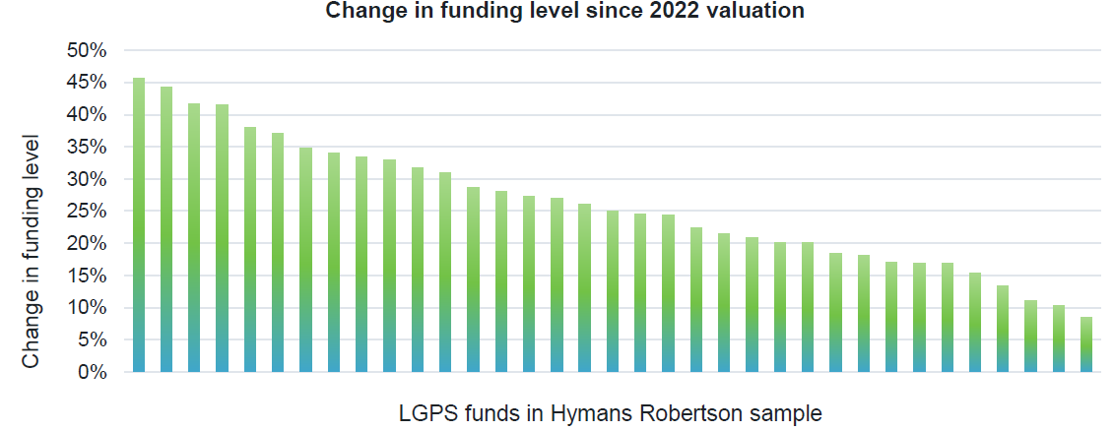
31 March 2025 valuation results
Typically expecting around a 25% increase in funding level
Source: initial results from Sept 2025 Hymans briefing note (actuary to most LGPS funds):
25% increase consistent with results we’ve seen to date for employers we advise
How much will contributions reduce by? Concern is there might only be modest reductions in contributions, even when employers are in large surplus positions
2025 LGPS valuations: insights into emerging results | Hymans Robertson

Slide 7
Case study: Spence client
Valuation results:
 | Ongoing basis
Date | 31 March 2022 | 31 March 2025
Assets | £22m | £21m
Liabilities | £18m | £14m
Surplus | £4m | £7m
Funding level | 122% | 150%
Cessation basis 31 Mar 2025
Low end | High end
£21m | £21m
£16m | £19m
£5m | £2m
130% | 110%
1) 28% increase in funding level
2) Very well funded on a cessation basis
Proposed contributions:
Employer contribution rate | Primary (% of pay p.a.) | Secondary (% or £ p.a.) | Total | Total Monetary (£ p.a.)
YE 31.3.26 | 33.0% | - | 33.0% | £56,000
YE 31.3.27 | 20.3% | - | 20.3% | £34,000
3) Contributions falling 10%+
4) But not using any surplus to fund future accrual, and £ of contributions is negligible in the context of the cessation surplus.

Slide 8
Top tip 1: understand exit credit policy
Funds have a discretion to pay exit credits to employers if there is a surplus on eventual cessation.
Assets £10m
Surplus £3m
Employers might be more comfortable with higher ongoing contributions if they have confidence overpayments will be returned as an exit credit on cessation.
Cessation Liabilities £7m
1) Will an exit credit be paid?
2) Will the fund keep some surplus?
3) What is the cessation basis?

Slide 9
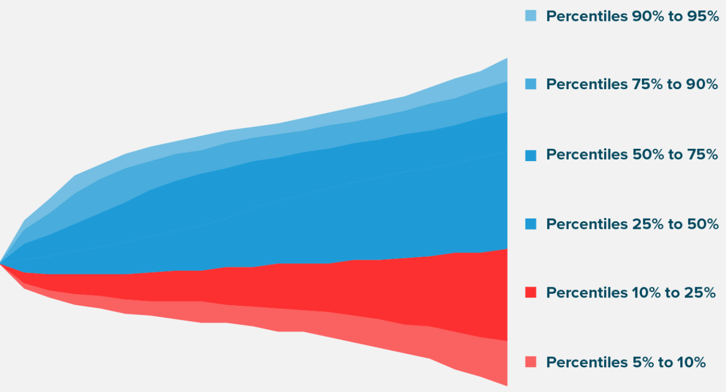
Top tip 2: check time horizon and investment strategy
Shortening the time horizon and reducing investment risk could reduce your cash contributions
Funding level
As the time horizon extends and investment risk is retained, the exposure to downside risk increases
100%
Time
Many funds set contributions to give an x% chance of still being fully funded in y years’ time

Slide 10
Top tip 3: consider exiting
Steps to exit:
Replacement pension for LGPS employees:
Feasibility assessment
LGPS: 49ths CARE, 6% ish employee contribution
Engage with Fund
Develop replacement offer
Enhanced DC + salary sacrifice
60ths DB + 0% employee contribution?
Consultation
Moving employees from LGPS to 60ths DB with 0% employee contribution is broadly cost and benefit neutral for employees
Implementation
Consider exiting to short time horizon and crystallise current surplus levels. Replacement pension not a barrier.

Slide 11
Next steps
Engage with your Fund to understand when your results will be available (if not already).
Review your Fund’s exit credit policy as it applies to your organisation. Will you recover over-payments on exit or not?
Form a view on your own time horizon for participating in LGPS.
Review valuation results when available.
Review investment strategy in the context of the funding level.
Potentially challenge the Fund if contributions seem high.
Ask if investment strategy can be changed to better protect current surplus position.
Consider exiting to access current surplus levels.

